Slide 1
DARTS Orientation

Slide 2
You’ve Been Approved
Accessible Transportation Services (ATS) has just approved you for DARTS service.
They’ve provided you with a passenger number that you can use to book trips.
Let’s first understand the dynamics of the service.

Slide 3
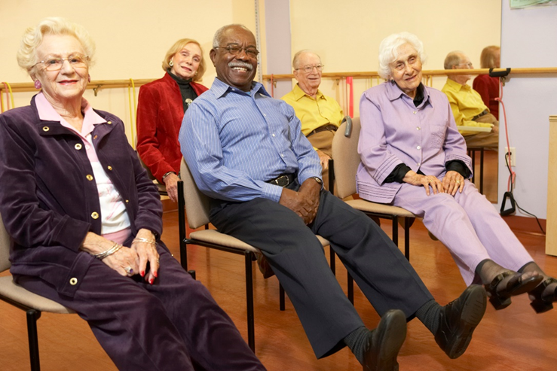
Who is Eligible?
Accessible Transportation Services are available to persons who, due to physical or functional limitations, are unable to use fixed-route public transit (HSR). Based on information obtained from the ATS Application Form and/or from an in-person functional assessment, eligibility is determined.

Slide 4
Accessible Transportation Services (ATS)
Accessible Transportation Services (ATS) is the City of Hamilton section that determines eligibility, registers passengers for DARTS and Taxi Scrip, and provides ongoing customer care. ATS is open between 8:30 am and 4:30 pm, Monday to Friday.
Call them to change profile information or provide feedback on the service at 905-529-1212

Slide 5
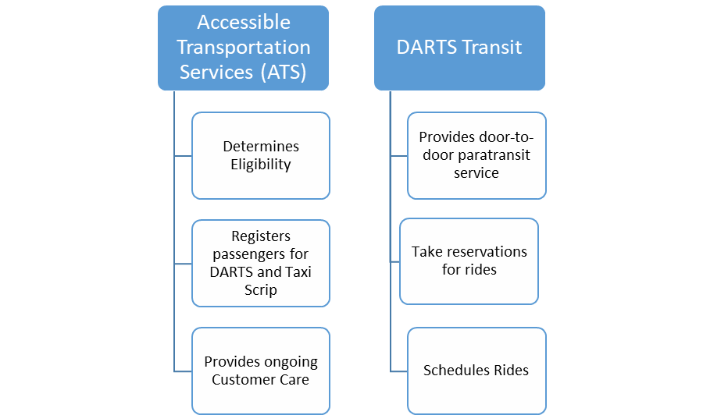
DARTS Transit
DARTS is the non-profit organization contracted to provide specialized transportation to the City of Hamilton. DARTS is a shared-ride, wheelchair accessible, door-to-door service, providing transportation throughout the City of Hamilton. DARTS also uses subcontractors and taxi service when necessary.
Call DARTS to book or cancel rides, set up subscription service or make group bookings.

Slide 6
DARTS Hours Of Operation
Monday to Friday 5:00am-2:00am
Saturday 6:00am-2:00am
Sunday 6:00am-12:30am
The earliest possible pick up time is 20 minutes after opening hours.
The latest possible drop off time is 30 minutes prior to closing hours.

Slide 7
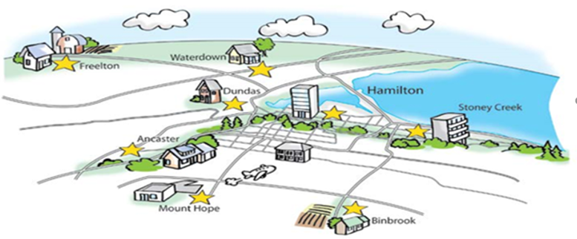
Where Does DARTS Travel To?
DARTS covers an area of 1,117 square kilometers which includes the entire city of Hamilton and rural areas, such as Dundas, Ancaster, Flamborough, Binbrook, Mount Hope, Winona, Stoney Creek, Waterdown and Freelton.
DARTS travels to 3 destinations in Burlington which are Joseph Brant Hospital, and the 2 GO stations at Aldershot and Fairview.
Many passengers use these locations in Burlington as transfer points to HandyVan, Burlington’s paratransit service.

Slide 8
Calling to Make a Reservation
You have your passenger number and now you want to book a trip. Call DARTS at 905-529-1717 or toll free at 1-855-831-5418
Reservations may be made up to 7 days in advance.
Please have the following information ready when you call:
- Name and DARTS Passenger Number
- Date you need a ride
- Time you wish to be picked up or your appointment time where applicable
- Your pick up address
- Your destination address
- Your return time
- If you are traveling with a mobility device, service animal, companion or support person

Slide 9
Call Returns
If you are attending a medical appointment and you cannot give DARTS a specific time for your trip home, you may request a “Call Return”.
When your appointment is finished, call DARTS at 905-529-1717, Ext. 1 for Call Returns.
Depending on vehicle availability, you may have an extended wait for your trip.

Slide 10
Waiting List
For trips that Reservations is unable to schedule at the time of your call, a waiting list will be offered.
DARTS will only contact you if they can accommodate your trip.
You are advised to call DARTS frequently at 905-529-1717, Ext. 0 to enquire about your waiting list trip.
The Waiting List is not a guarantee of a trip.
In the event that DARTS is unable to accommodate your waiting list trip, you are advised to make alternate travel plans, e.g. the Taxi Scrip Program.

Slide 11
Riding on DARTS
DARTS is a shared-ride service and you will not always be the only person on board. Please allow for adequate time to reach your destination.
Passengers must be ready and waiting at the start of the 30 minute pick up window. DARTS may arrive between 15 minutes before or 15 minutes after the negotiated pick up time.
When drivers arrive early, they must wait until the start of the passenger’s 30 minute pick up window. Drivers will wait for 5 minutes only. If the passenger is not ready to leave, a cancellation will be recorded.
If a vehicle has not arrived by the end of your pickup window, call DARTS at 905-529-1717, Ext. 1 to report a late vehicle.

Slide 12
Safety
Passengers may board with up to 2 carry-on items, which must be maintained under the control of the passenger at all times during their trip.
DARTS drivers will assist passengers with wheelchairs up or down one step only, to and from an accessible entrance. If you need greater assistance at your pick-up or drop-off points, please arrange for a support person to help you.
Passengers using scooters are encouraged to transfer to a seat. If a scooter does not have a seatbelt, passenger MUST transfer to a seat. Passengers using wheelchairs must have both a seat belt and footrests installed. DARTS vehicles accommodate mobility devices up to 30” (76 cm) wide and 48” (122 cm) long. DARTS vehicles accommodate a maximum weight of 800 lbs (363 kg).
Video Surveillance Cameras are used on all DARTS vehicles to enhance the safety and security of people/property, reduce crime on City property, and to assist in the risk management and insurance process.

Slide 13
DARTS FLEET

Slide 14
Cancellations
DARTS Cancellations: 905-529-1717 or 1-855-831-5418, Ext. 1
PLEASE CANCEL AS EARLY AS POSSIBLE to assist DARTS in accommodating other trip requests, and to avoid exceeding the allowable cancellation limits.

Slide 15
Cancellation Policy
Each 30 day period, ATS/DARTS will review passenger records and ATS will issue advisory letters to those who have incurred 50 points.
Points are incurred as follows:
No Show = 8 points
Cancel at Door = 6 points
Late Cancel = 3 points
Advance Cancel = 0 points (counts towards percentage cancellation rate)
25% cancellation rate with at least 10 cancellations a month

Slide 16
Subscription Trips
If you make routine trips for the same time and destination each week, DARTS may be able to arrange a “Subscription” trip.
DARTS will arrive automatically, eliminating the need to call weekly to make reservations.
Call DARTS at 905-529-1717, Ext. 4 to place a request for subscription trips.
Subscriptions are approved only if space is available. You will need to reserve rides day by day if your subscription trips cannot be accommodated.
Subscription trips are automatically cancelled on Statutory Holidays. If you still need to travel on these dates, you must call DARTS reservations to book your trips.

Slide 17
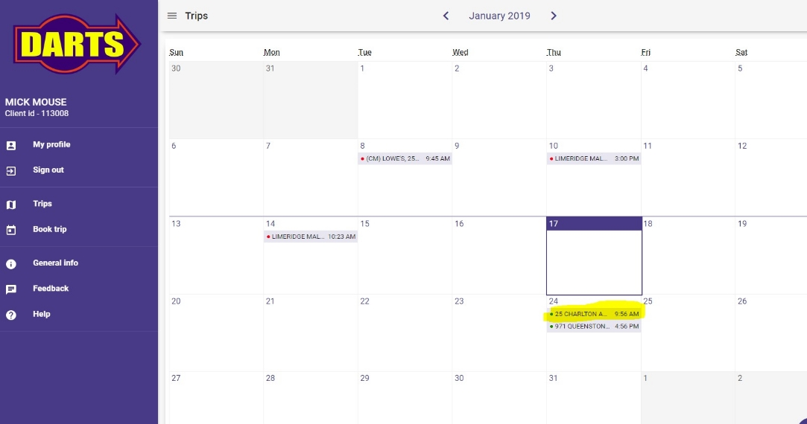
Online Services
First call into DARTS at 905-529-1717 to get a password for Online Services.
You can book and cancel trips online at www.dartstransit.com and click “Web Booking”
It’s fast and easy to manage your bookings online

Slide 18
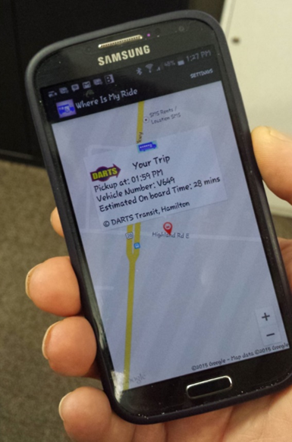
Where is My Ride
DARTS Where is My Ride is available on www.dartstransit.com and you can also download the “Where Is My Ride” app for your cell phone from Google Play and Apple Store.
This application shows the approximate location of your vehicle up to 30 minutes prior to your negotiated time.
Once picked up, Where’s My Ride will continue to track your ride, showing your estimated drop off time.
This is especially helpful for loved ones wanting to know when the vehicle will drop the passenger off to them.

Slide 19
Ride Advise
Contact Passenger Services at 905-529-1717 ext 3851 and sign up to receive a phone call 10 minutes prior to your vehicle’s arrival time.

Slide 20
Support Persons/Companions
One support person may travel on DARTS for free with a registered passenger. Medical certification for a support person must be registered in advance with ATS.
Passengers who register as requiring a support person at all times MUST be accompanied for all trips and may not travel alone on DARTS.
No medical certification is necessary to travel with a companion, but companions are required to pay the applicable HSR/DARTS fare.

Slide 21
Do Not Leave Unattended
If there is a safety risk to the passenger being left alone at their destination, ATS may register the passenger as “Do Not Leave Unattended”.
The passenger may travel independently on DARTS; however a caregiver MUST be at every destination to receive the passenger.

Slide 22
Guide Dogs and Pets
It is the responsibility of the passenger to inform DARTS that they will be travelling with a guide dog, service animal or pet at the time of booking the trip.
This is to ensure that the appropriate assigned vehicle is able to accommodate the passenger and their animal.
Small lap dogs or other small pets must travel in an animal carrier device which can be securely transported in the passenger’s or escort’s lap.
Service animals and Guide Dogs that are identified as such, are permitted aboard DARTS vehicles without restriction.

Slide 23
Service Interruptions
In the interest of safety, DARTS will cancel service due to snow, ice, or dangerous road conditions.
Service interruptions are announced on local television and radio, www.dartstransit.com, or by calling DARTS at 905-529-1717

Slide 24
DARTS Fares
The cost for DARTS and the regular HSR is the same.
Fare is based on age.
- Student $2.05
- HSR Adult $2.50
- Senior $20.50 for book of 10 tickets
- Golden Age (80+) Free
Online payments can be made at www.dartstransit.com

Slide 25
Taxi Scrip
The Taxi Scrip Program provides subsidized taxi fares to DARTS users, allowing passengers to receive a 40% discount when travelling with local taxi companies (Blueline and Hamilton Cab).
Taxi Scrip coupons cost $24 per book and you receive $40 worth of Taxi Scrip coupons.
Please contact ATS at 905-529-1212 for more information on Taxi Scrip and to purchase coupons.

Slide 26
Change of Information
If your personal information has changed, please contact ATS Customer Service at 905-529-1212, Ext. 1
This includes changes in address, telephone number, emergency contact information, fare type or mobility type.
In order to provide a safe and reliable service, your personal information must be kept current and up to date.

Slide 27
Any Questions?
If you have any questions, please contact DARTS at 905-529-1717
We are happy to help and welcome you to the service.

